Slide 1
Face recognition ATTENDANCE SYSTEM
By-
Tanveer shikalgar
Akshay vanjare
Suleman sayyed
Under the Guidance-
Miss. Ankita Kanchan (Director at PiSyst India Pvt . Ltd)

Slide 2
The Problem
What is the problem?
Management of attendance data.
Who has this problem?
Every schools, colleges, and many institutes too.
Why should this problem be solved?
For ease to work flow.
How will I know this problem has been solved?
By ML model with max accuracy

Slide 3
Workable Solutions
Solution #1
What materials does this solution require?
Barriers like unavailability of training and testing dataset required for model.
What are some barriers you might come across with this solution?
1.PYTHON IDE like - Jupyter_Notebook
2.MYSQL
PyCharm
Spyder
Dataset splitting.
Data feeding to SQl through python codes.
And some minor programming errors.

Slide 4
AGENDA
Definition
Scope
Project Status
Methodology
Data Flow Diagrams
System Architecture
Database Dictionary
Database Diagram
Demo
Designing of System(Snaps)
Learning and Experience

Slide 5
Definition
Facial Recognition is a way of identifying or confirming an individual's identity using their face. Facial recognition systems can be used to identify people in photos, videos, or in real-time. Facial recognition is a category of biometric security.
Face Recognition Attendance System is marking attendance based on this technology

Slide 6
Scope
Helps to automate attendance system practically, which reliable and eliminate time loss of traditional attendance system.
Provides system that can evaluate students performance depending on their attendance rate.

Slide 7
Project status: completed
Dataset Collection
Status: Complete
Model Designing
Status: Complete
Coding
Status: Complete

Slide 8
Methodology
Requirements
Design
Implementation
Verification
Maintenance
Waterfall model is a breakdown of project activities into linear sequential phases, where each phase depends on the deliverables of the previous one and corresponds to a specialization of tasks.
The waterfall model maintains that one should move to a phase only when its preceding phase is reviewed and verified.

Slide 9
System context diagram
Student
Faculty
Enter details
Enters Report
Validates details
Generates Report
Webcam
Attendance System
Admin
Captures Image
Manages the system
Enables
Provides generated report

Slide 10
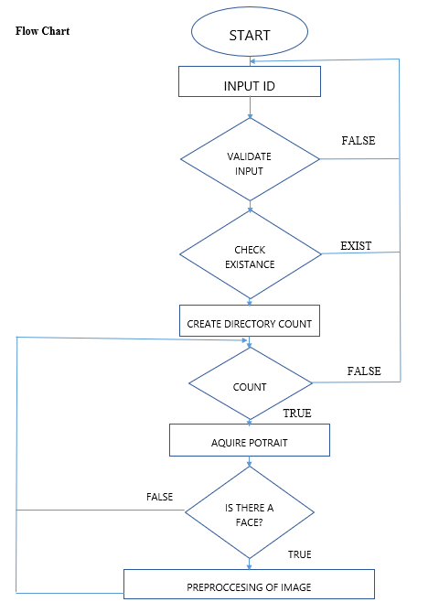
Dfd (Data flow diagram) level

Slide 11
System Architecture
Training phase registration-
Student
Login Datails
Registered Student
Webcam
Capture image
Detect Faces
Training Set

Slide 12
System Architecture
Testing phase: Attendance
Faculty
Login details
Attendance sheet
Webcam
Captured image of class
Detect Faces
Testing Set

Slide 13
System architecture
Recognition Phase
Training Set
Testing Set
Feature Extraction
Feature Extraction
Feature Classification
Feature Classification
Face Recognition
Attendance Sheet

Slide 14
Database dictionary
Field Name | Data Type | Length | Constraint | Description
Id | Int |  | Primary key | Student Id
Name | varchar |  | Not null | Name of student
Datetime | datetime | 10 | Not null | Date and time of the attendance

Slide 15
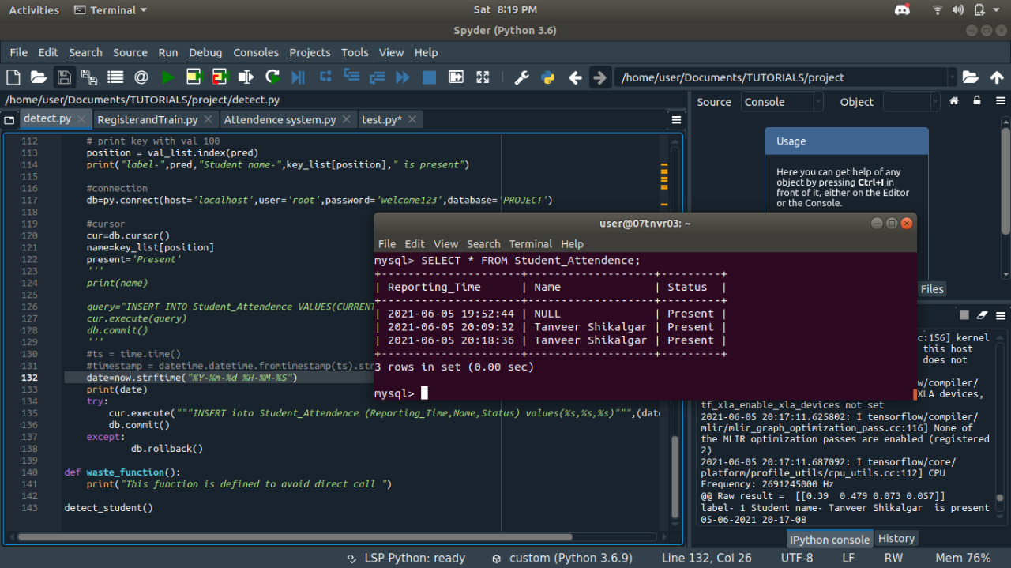
Database Design

Slide 16

Home

Slide 17
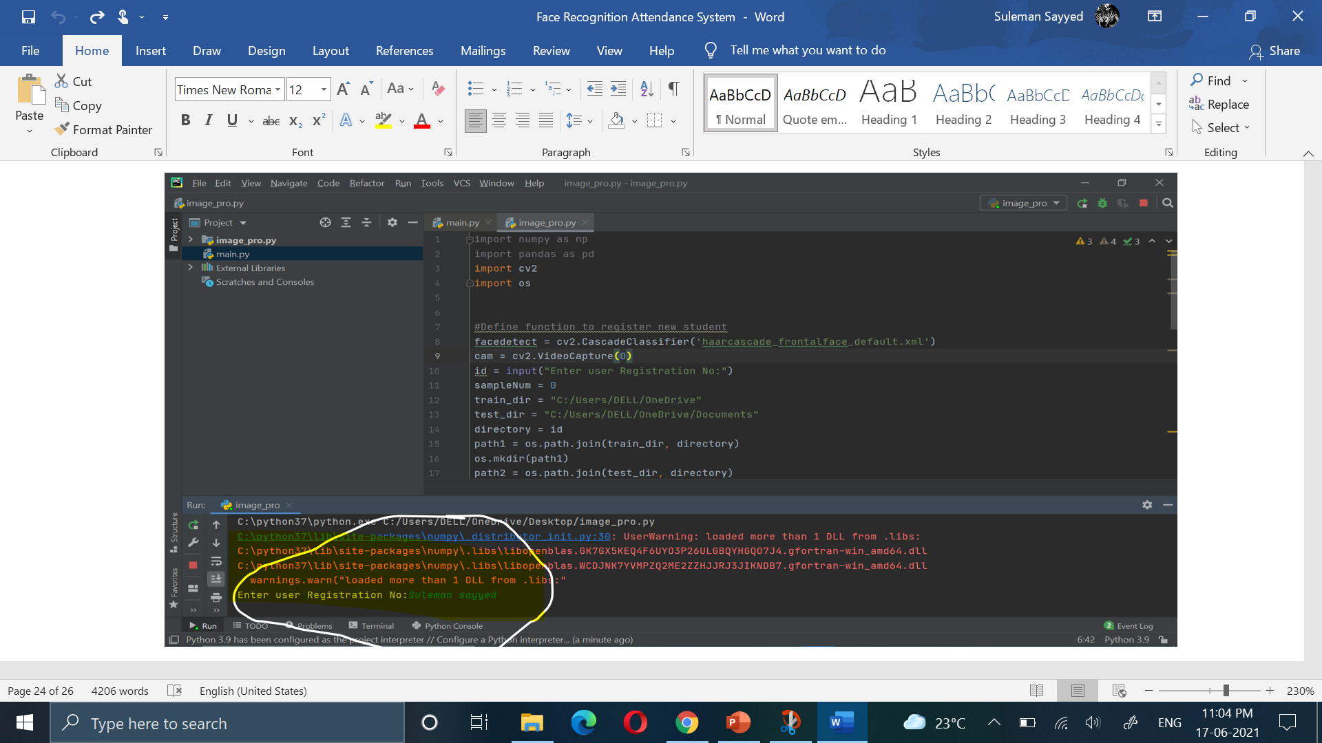
Registration

Slide 18
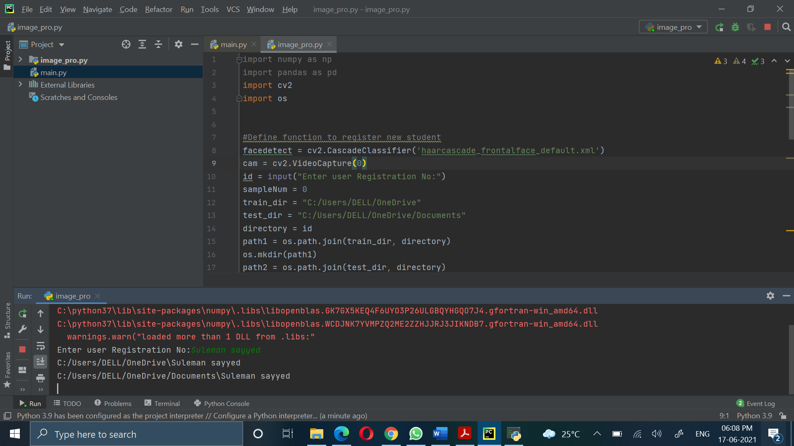
Registering Image

Slide 19

Training set

Slide 20
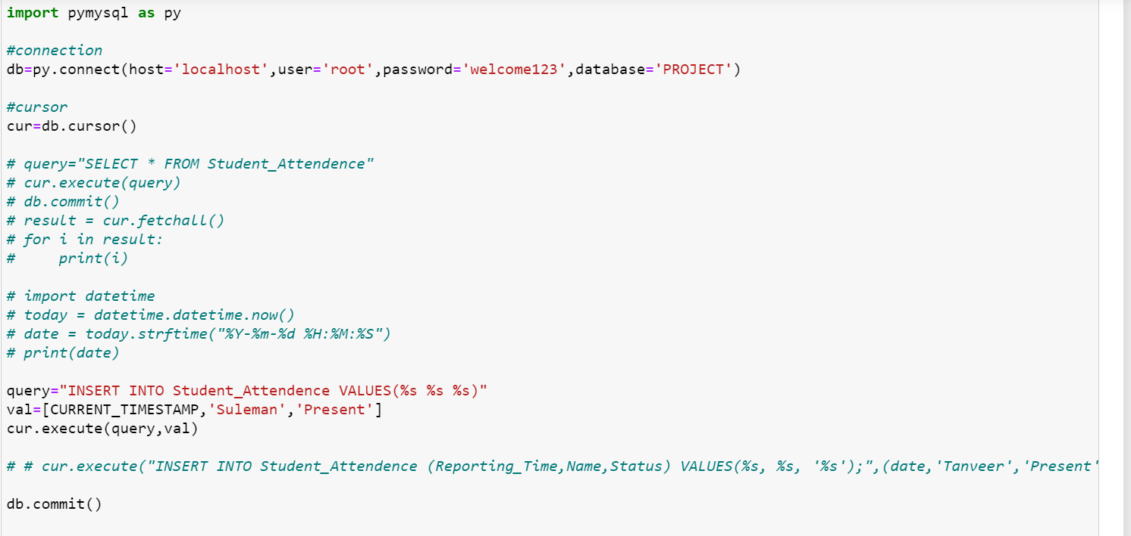
Attendance time

Slide 21
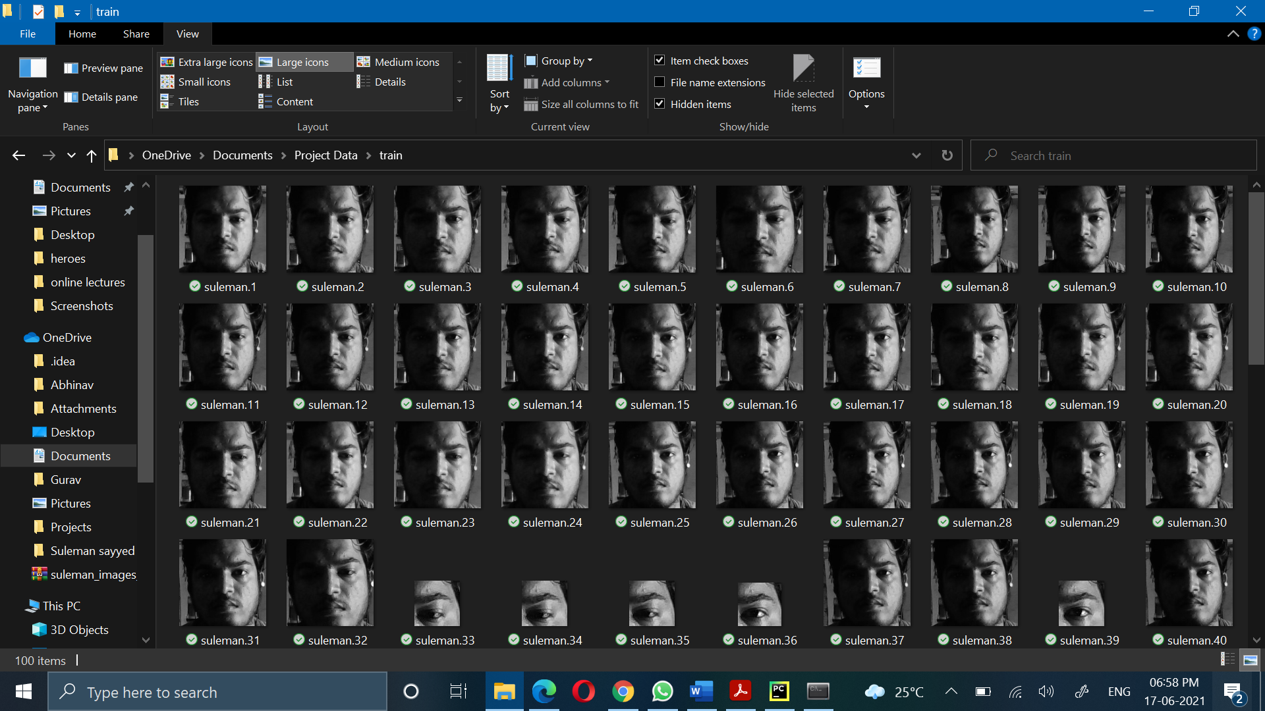
Recognised faces

Slide 22

Generated attendance

Slide 23
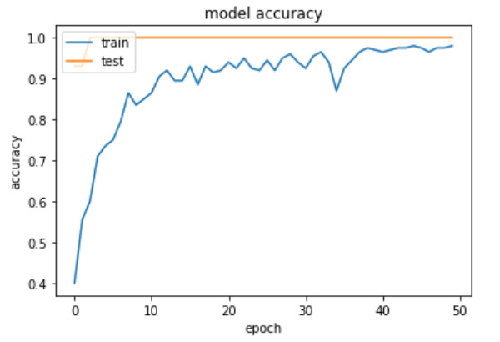
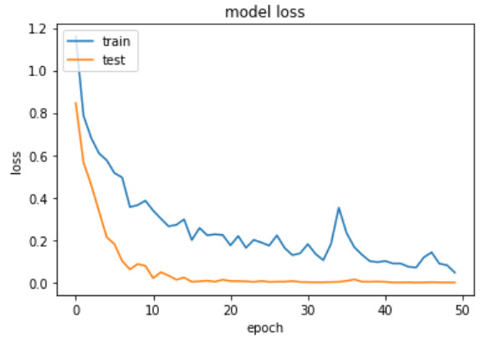
Accuracy

Slide 24
conclusion
The facial recognition feature embedded in the attendance monitoring system can not only ensure attendance to be taken accurately and also eliminated the flaws in the previous system. By using technology to conquer the defects cannot merely save resources but also reduces human intervention in the whole process by handling all the complicated task to the machine. The only cost to this solution is to have sufficient space in to store all the faces into the database storage. In this project, the face database is successfully built.

Slide 25
Thank you

